Slide 1
Law Codes
By Luke Lattanzi

Slide 2
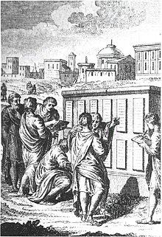
The Twelve Tables (451-450 B.C.)
The Roman Twelve Tables are the earliest known codification of Roman law and formed the general basis for all Roman law.
Allegedly written by 10 commissioners (decemvirs) at the insistence of the plebeians, who felt that their rights were being violated, largely due to the law beforehand being largely unwritten, which allowed for the patricians to enforce the law on a whim and abuse their power. Significance:
Abolished the use of torture as a means of obtaining evidence from free men
Guaranteed the right to property for free men
Provided for the intervention of the state in civil disputes
Empowered plebeians to better fight against the patricians’ abuse of power
The Twelve Tables fixed in writing the preexisting law of customs passed down from the patricians.
In general –
The Twelve Tables are significant because they established in principle the equality of all free citizens before the law in Rome.

Slide 3
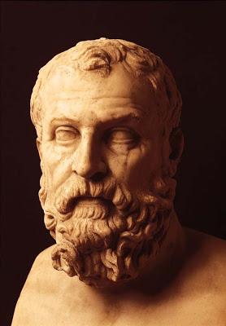
The Laws of Solon and How They Transformed Athens
Who was Solon?
Solon was an Athenian lawgiver and poet who is known for reforming Athenian society – which was previously dominated by aristocracy – and abolished the political monopoly on the eupatridae (Athenian nobility).
Solon’s Laws
Solon instituted a new code of laws for Athens, which ended the rule of Draco’s Law Codes, which were shockingly cruel in many respects (hence the term draconian). Solon however, left the homicide law from Draco unchanged.

Slide 4
What Solon’s Laws Changed
Unlike the previous laws of Draco, citizens could no longer be enslaved to pay their debts
Forgave all debts previously incurred by citizens to the aristocracy
Redeemed all land previously forfeited by citizens to the aristocracy
These changes became known as the “shaking off of burdens”. In general –
Solon’s laws, though being eventually heavily modified, served as the sole foundation of Athenian law until the end of the 5th Century, and parts of Solon’s Code remained in effect throughout future codifications.

Slide 5

The Law Code of Gortyn
Gortyn was a Greek city on the island of Crete, which codified its own code of law. The code regulated things such as:
Property
Inheritance
Rape
Adultery
Slavery
Adoption
Marriage
Children of unwed mothers
And many more
The Gortyn Code, unlike Solon’s laws or the Twelve Tables, is the only code to still exist in physical form, and still sits in the ancient site of Gortyn.

Slide 6
Bibliography
Britannica, T. Editors of Encyclopaedia. "Law of the Twelve Tables." Encyclopedia Britannica, March 29, 2018. https://www.britannica.com/topic/Law-of-the- Twelve-Tables.
Cadoux, T. John. "Solon." Encyclopedia Britannica, April 13, 2020. https://www.britannica.com/biography/Solon.
Library, Cornell University. “The Law Code of Gortyn - Cornell University Library Digital Collections.” The Law Code of Gortyn - Cornell University Library Digital Collections: Cornell Cast Collection. Accessed February 12, 2021. https://digital.library.cornell.edu/catalog/ss:8294784.
Schultz, C., Ward, A., Heichelheim, F. and Yeo, C., 2019. History of the Roman People. Routledge.

